Slide 1
Funding Opportunities in Life Sciences Education & Research in Europe and Greece
Dina Baga
Liaison Office Administration
Research Committee
University of Ioannina

Slide 2
What will be presented?
Funding opportunities in Europe
Funding opportunities in Greece
Open and Expected Calls
Liaison Office: how can we be of assistance?

Slide 3
Funding Opportunities in Europe
FP7
ESF
ESOF
EUROPA
Prizes/Awards
Other Initiatives
Notes:
2013 is a transitional period regarding European Funding for Research and development
FP7 the current framework programme is coming to an end, and the new programme HORIZON 2014-2020 will begin in 2014.
The new programmes’ budget is not yet decided, and a lot depend on that.
Since in all previous programmes (I have personal experience since FP5) the last year of each programme is actually the frontrunner of the first years of the next, so although not many calls are open this transitional period, I believe that trying to present where opportunities lied in the previous programme will give you hints on where to look for funding on in the future. A few words will be dedicated on what we know so far on the new HORIZON 2014-2020 programme.

Slide 4
FP7

Slide 5
IDEAS
ERANET Scheme
Joint Technology Initiatives (JTIs)
CAPACITIES
ERC GRANTS
PEOPLE
IMI
New
HORIZON 2014-2020
EuroTransBio
TRANSCAN
HEALTH
COOPERATION
FP7

Slide 6
FP7
COOPERATION
HEALTH

Slide 7
COOPERATION
FP7
HEALTH
LAST CALLS: September and October 2012
FOCUS:
Translational Research
Anti- microbial resistance
Imaging Technologies
Safety/Efficacy of Therapies (Modeling, Adverse Reactions)
Stem Cells
Integrating Biological Data and Processes
Brain Diseases
Infectious Diseases
Cancer
Cardiovascular Diseases
Clinical Outcomes into Clinical Practice

Slide 8
COOPERATION
FP7
BUT NOT ONLY ……
KBBE – Food Agriculture And Fisheries, And Biotechnology
LAST CALLS: January/February 2013
Biological products
Food and Health
Life Science, Biotechnology and Biochemistry for non-food products and processes
ICT- Information And Communication Technologies
Cognitive Systems and Robotics
ICT for Health, Ageing Well
ICT for low carbon economy
OPEN CALLS?: March/April 2013

Slide 9
COOPERATION
FP7
BUT NOT ONLY ……
NMP- NanoMaterials and Processes
LAST CALLS: December 2012
Materials: nanotechnology and biotechnology for new products and processes
SPACE
LAST CALLS: November 2012
Strengthening Space Foundation: biomedicine, life and physical sciences in space
SECURITY
LAST CALLS: November 2012
Increasing the security of citizens: bio-security

Slide 10
IDEAS
ERANET Scheme
Joint Technology Initiatives (JTIs)
CAPACITIES
ERC GRANTS
PEOPLE
IMI
New
HORIZON 2014-2020
EuroTransBio
TRANSCAN
HEALTH
COOPERATION
FP7

Slide 11
FP7
IDEAS
ERC GRANTS

Slide 12
IDEAS
FP7
ERC GRANTS
OPEN CALLS: PoC only- April and October 2013
FOCUS:
Physical Sciences & Engineering
Life Sciences
Social Sciences & Humanities
TYPES OF GRANTS:
Starting Grants: 2-7 years after Phd (October 2012)
Consolidator Grants: 7-12 years after Phd (February 2013)
Advanced Grants: Leaders in Research Fields (November 2012)
Synergy Grants: Small Groups of Excellent Researchers
Proof of Concept: ERC Grantees to make it to the market

Slide 13
IDEAS
ERANET Scheme
Joint Technology Initiatives (JTIs)
CAPACITIES
ERC GRANTS
PEOPLE
IMI
New
HORIZON 2014-2020
EuroTransBio
TRANSCAN
HEALTH
COOPERATION
FP7

Slide 14
FP7
PEOPLE

Slide 15
PEOPLE
FP7
PEOPLE
OPEN CALLS: Announcement Expected
TYPES OF ACTIONS (TARGETED TO ORGANISATIONS):
Initial Training Networks (ITN): (November 2012)
Multipartner Doctorates: 3 of {UNI, RE, CO}
European Industrial Doctorates (EID): 1 UNI, 1 CO (50% time)
Innovative Doctorates (IDP): 1 UNI – innovative program
Industry-Academia Partnerships and Pathways (IAPP): (January 2013)
Build Strategic Research Partnership
1+ of {UNI, RE} AND 1+ of {CO}

Slide 16
PEOPLE
FP7
PEOPLE
OPEN CALLS: Announcement Expected
International Research Staff Exchange Scheme (IRSES) (January 2013)
2 of EU {UNI, RE} AND 1 of {Argentina, Australia, Brazil, Canada, Chile, China, Egypt, India, Japan, Jordan, Korea, Mexico, Morocco, New Zeland, Russia, South Africa, Ukraine, USA, EU Neighboring Countries}
Individual Support 12 months

Slide 17
PEOPLE
FP7
PEOPLE
OPEN CALLS: Announcement Expected
TYPES OF ACTIONS (TARGETED TO INDIVIDUALS):
Intra-European Fellowships for career development (IEF) (announcement expected)
MS OR 4 Years full-time Research
Degree which allows PhD to be obtained afterwards
Personal career development programme
12-24 months in Host Organisation
Career Integration Grants (CIG): (7/3/2013)
Phd OR 4 year research experience
2-4 years personal research costs
Host = 1 of {UNI, RE, CO}

Slide 18
PEOPLE
FP7
PEOPLE
OPEN CALLS: Announcement Expected
International Incoming Fellowships (IIF): (announcement expected)
Top Class researcher from Third Countries moving to EU
Transfer knowledge into Host Organisation
Min. Phd + 4 years researcher experience after
International Outgoing Fellowships for career development (IOF) (announcement expected)
Researchers from EU to Third Countries
Acquire knowledge from Host Organisation
Up to 3 years but REINTEGRATION in EU
Notes:
Έχουν και forthcoming

Slide 19
IDEAS
ERANET Scheme
Joint Technology Initiatives (JTIs)
CAPACITIES
ERC GRANTS
PEOPLE
IMI
New
HORIZON 2014-2020
EuroTransBio
TRANSCAN
HEALTH
COOPERATION
FP7

Slide 20
FP7
ERANET Scheme
TRANSCAN
EuroTransBio

Slide 21
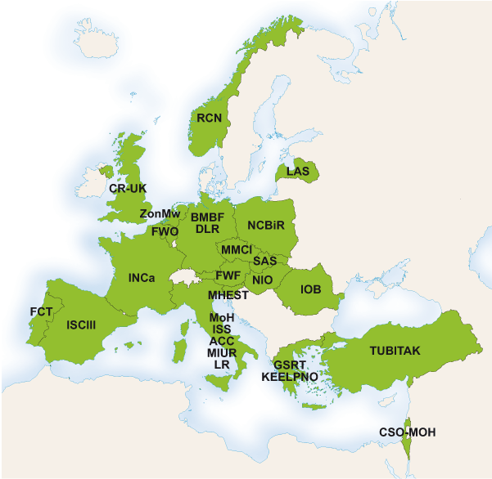
European Research Area Networks ERA-Nets
FP7
NEXT CALL: Expected December 2013
ERA-NET on Translational Cancer Research
Running until December 2014
Collaboration for:
Integration of basic, clinical and epidemiological cancer research
Facilitation of transnational cancer funding in Europe
In order to streamline:
EU-wide cancer screening,
early diagnosis,
prognosis,
treatment and
care

Slide 22
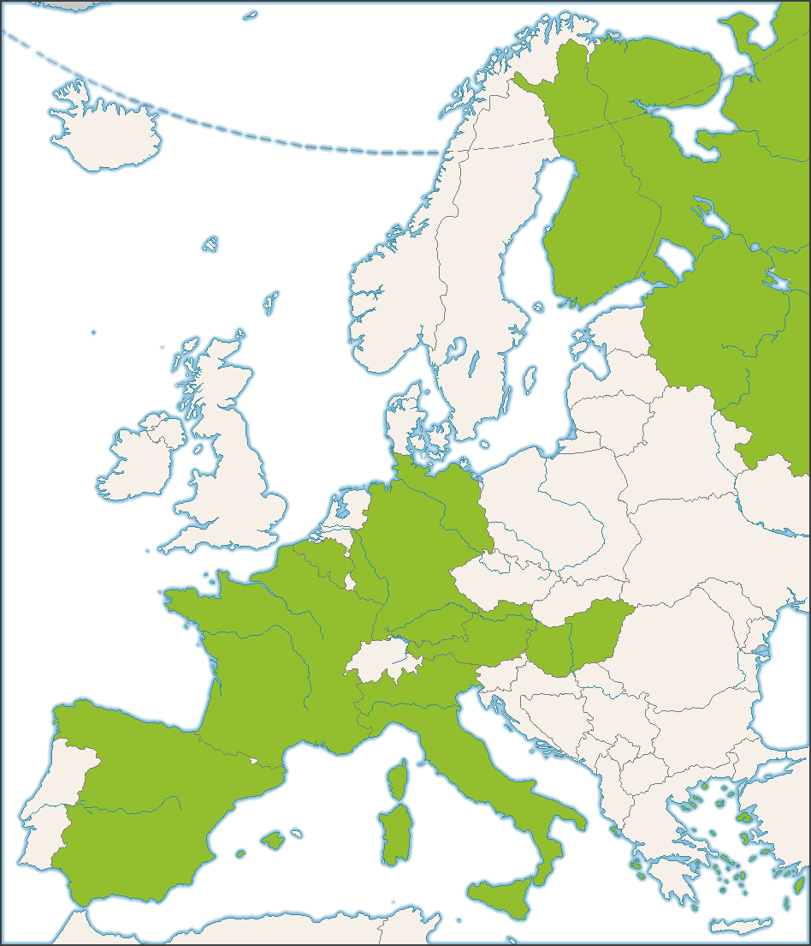
European Research Area Networks ERA-Nets
FP7
NEXT CALL: October 2013
EuroTransBio
Since 2013 running with own funding resources
Funds:
Innovative near to the market R&D&I projects
In all fields of modern biotechnology (health, agro/food, industrial biotech, environment, marine/aquatic solutions)
Requires:
1 SME + 2 Enterprises + ? Research

Slide 23
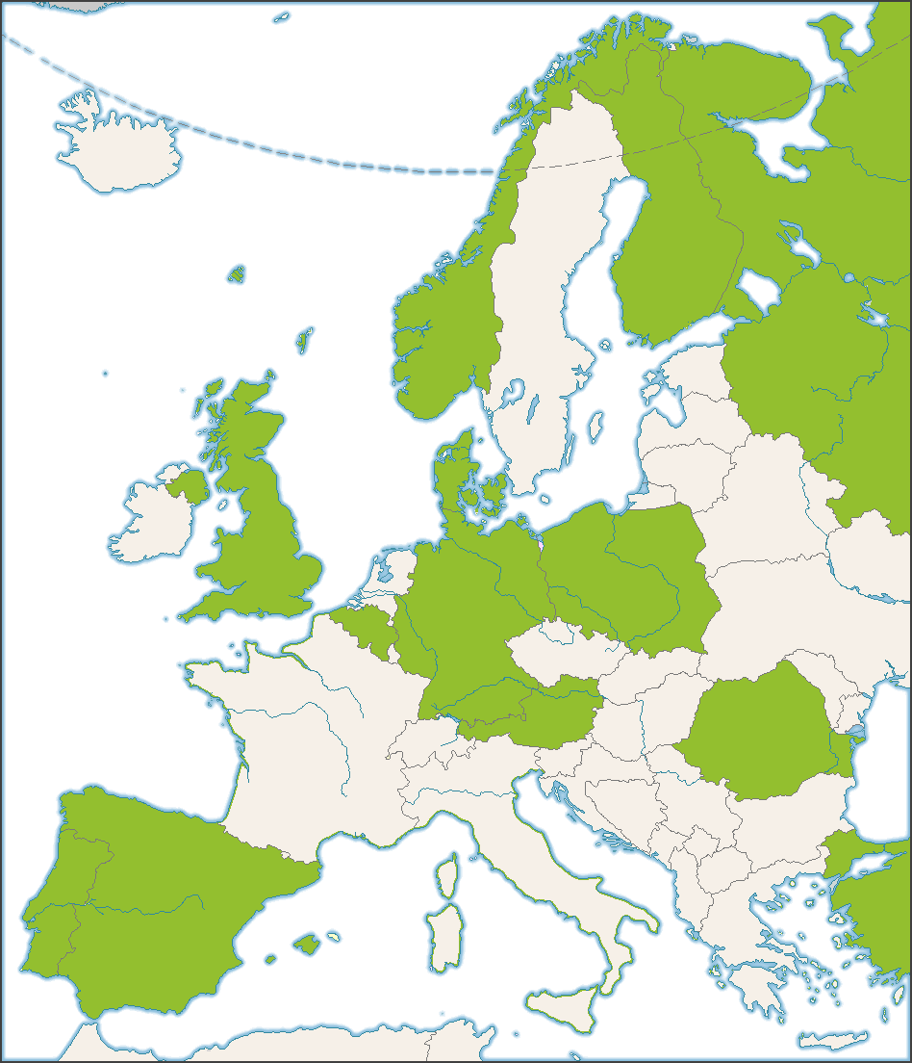
European Research Area Networks ERA-Nets
FP7
OPEN CALL: 26 March 2013
ERA-IB (Industrial Biotechnology)
Running until 2015
Innovative Industrially Relevant Research and Development projects :
Improved enzyme
Metabolic engineering of microorganisms
Novel down-stream processes Fermentation and bio-catalytic processes
Biological processing (including separation and conversion) of biomass
plant- and animal cell cultures
Requires:
3 of {UNI, RE, CO} in 3 countries
Max. 8

Slide 24
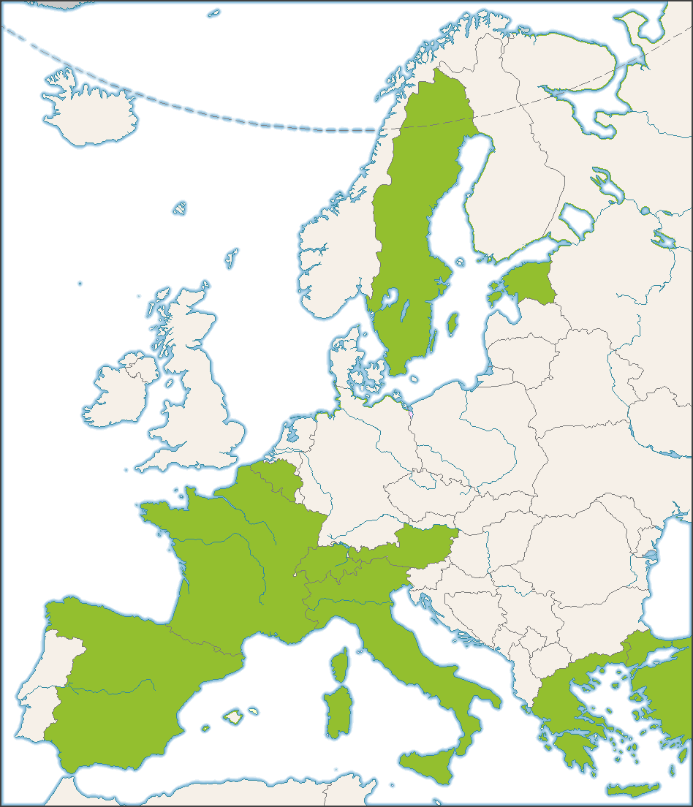
European Research Area Networks ERA-Nets
FP7
OPEN CALL: 15 March 2013
LeadERA
Foster coordination of a series of trans-regional programmes dedicated to research and innovation within the highly innovative and technology based themes:
eHealth,
Protective textiles,
Sustainable construction,
Recycling,
Bio-based products and
Renewable energies
Requires:
2 INDUSTRY from 2 Regions
(In Greece->Western Greece)

Slide 25
European Research Area Networks ERA-Nets
FP7
MORE ERA-Nets will be created in 2014,
Since an ERANET Call is open for submissions
Until 28/2/2013.
In these CALLS only National Authorities with the
Ability to fund projects can participate
BUT watch out, because NEW opportunities will appear.

Slide 26
IDEAS
ERANET Scheme
Joint Technology Initiatives (JTIs)
CAPACITIES
ERC GRANTS
PEOPLE
IMI
New
HORIZON 2014-2020
EuroTransBio
TRANSCAN
HEALTH
COOPERATION
FP7

Slide 27
FP7
Joint Technology Initiatives (JTIs)
IMI

Slide 28
Joint Technology Initiatives
FP7
Innovative Medicine Initiative (IMI)
OPEN CALL: 19 March 2013
The Innovative Medicines Initiative (IMI) is Europe's largest public-private initiative aiming to speed up the development of better and safer medicines for patients.
Current Call Focus:
Antimicrobial resistance (two topics)
Taxonomy of disease - two topics:
Rheumatoid arthritis & lupus
Alzheimer's disease & Parkinson's disease
European induced pluripotent stem cell bank
Requires:
2 of {SME, Non Profir RE, UNI, Patient Associations} BUT independent of EFPIA CO

Slide 29
Joint Technology Initiatives
FP7
Innovative Medicine Initiative (IMI)
New CALLs are expected
Focus most probably will be on:
Drug-drug combinations
Pharmacovigilance

Slide 30
IDEAS
ERANET Scheme
Joint Technology Initiatives (JTIs)
CAPACITIES
ERC GRANTS
PEOPLE
IMI
New
HORIZON 2014-2020
EuroTransBio
TRANSCAN
HEALTH
COOPERATION
FP7

Slide 31
FP7
CAPACITIES

Slide 32
CAPACITIES
FP7
It is dedicated to supporting research, through:
Building and maintaining infrastructures with pan-European interest,
Supporting SMEs to outsource research activities,
Creating regional research agendas,
Developing bi-regional cooperation and bi-lateral cooperation

Slide 33
CAPACITIES
FP7
OPEN CALL: 15 October 2013
Prizes for Women Innovators

Slide 34
IDEAS
ERANET Scheme
Joint Technology Initiatives (JTIs)
CAPACITIES
ERC GRANTS
PEOPLE
IMI
New
HORIZON 2014-2020
EuroTransBio
TRANSCAN
HEALTH
COOPERATION
FP7

Slide 35
FP7
New
HORIZON 2014-2020

Slide 36
HORIZON 2014-2020
FIRST CALLS: BEGINNING 2014
Excellent Science
ERC
FET
MARIE CURIE (PEOPLE)
RESEARCH INFRASTRUCTURES

Slide 37
HORIZON 2014-2020
FIRST CALLS: BEGINNING 2014
Industrial capabilities in Key Enabling Technologies (KETs)
Micro- and nano-electronics; photonics
Nanotechnologies
Advanced materials
Biotechnology
Advanced manufacturing and processing
Development of these technologies requires a multi-disciplinary, knowledge and capital-intensive approach.

Slide 38
HORIZON 2014-2020
FIRST CALLS: BEGINNING 2014
Policy Priorities
Health, demographic change and wellbeing;
Food security, sustainable agriculture, marine and maritime research, and the bio-economy;
Secure, clean and efficient energy;
Smart, green and integrated transport;
Inclusive, innovative and secure societies;
Climate action, resource efficiency and raw materials.

Slide 39
Funding Opportunities in Europe
FP7
ESF
ESOF
EUROPA
Prizes/Awards
Other Initiatives

Slide 40
EUROPA

Slide 41
EUROPA/ EUROPEAN COMMISION/ EXECUTIVE AGENCY FOR HEALTH AND CONSUMER/ HEALTH PROGRAMME
EUROPA
OPEN CALL: 22 MARCH 2013
Focus on:
IMPROVING CITIZENS' HEALTH SECURITY (HIV/AIDS focus)
PROMOTING HEALTH (Chronic Diseases/ Elderly focus)

Slide 42
EUROPA/ ENVIRONMENT/
LIFE PROGRAMME
EUROPA
OPEN CALL: 25 JUNE 2013
LIFE + FOCUSES ON:
Nature & Biodiversity
Environmental and Health Policy

Slide 43
Funding Opportunities in Europe
FP7
ESF
ESOF
EUROPA
Prizes/Awards
Other Initiatives

Slide 44
ESF

Slide 45
European Science Foundation
ESF
OFFERS GRANTS FOR SHORT VISITS AND EXCHANGES
Through Currently Running Research Networks And Projects:
Life, Earth and Environmental Sciences
QUAN TISSUE: Quantitative Models and Cellular and Developmental Biology
Medical Sciences
European Network for Gastrointestinal Health Research (ENGIHR)
The Identification of Novel Genes and Biomarkers for Systemic Lupus Erythematosus (BIOLUPUS)
European Network for the Study of Adrenal Tumors (ESF-ENS@T)
Functional Genomic Variation in the Epilepsies (EuroEPINOMICS),

Slide 46
Funding Opportunities in Europe
FP7
ESF
ESOF
EUROPA
Prizes/Awards
Other Initiatives

Slide 47
ESOF

Slide 48
EuroScience Open Forum
ESOF
Call for Young Researcher’s Award
(each year, deadline around April)

Slide 49
Funding Opportunities in Europe
FP7
ESF
ESOF
EUROPA
Prizes/Awards
Other Initiatives

Slide 50
Prizes/Awards

Slide 51
Prizes/Awards
Universal biotech innovation prize 2013
InBEV-BAILLET LATOUR PRIZES
….

Slide 52
Funding Opportunities in Europe
FP7
ESF
ESOF
EUROPA
Prizes/Awards
Other Initiatives

Slide 53
Other Initiatives

Slide 54
COST
Other Initiatives
COST does not fund research itself but provides a platform for European scientists to cooperate on a particular project and exchange expertise.
One of the key domains for COST is:
Biomedicine and Molecular Biosciences (BMBS)
Specific domain proposals
Trans-domain proposals
OPEN CALL: 29 March2013

Slide 55
INTERREG
Other Initiatives
BILATERAL COOPERATION
Greece-Albania,
Greece-Bulgaria,
Greece-Cyprus,
Greece-Former Yugoslav Republic of Macedonia,
Greece-Italy
MULTILATERAL COOPERATION
Adriatic,
Black Sea,
Interreg IVC,
MED,
MED ENPI,
SEE

Slide 56
Funding Opportunities in Greece
ΥΠΟΥΡΓΕΙΟ ΠΑΙΔΕΙΑΣ (ΜΕΣΩ ΕΣΠΑ)
ΠΕΠ
ΑΛΛΕΣ ΠΡΩΤΟΒΟΥΛΙΕΣ

Slide 57
ΥΠΟΥΡΓΕΙΟ ΠΑΙΔΕΙΑΣ (ΜΕΣΩ ΕΣΠΑ)

Slide 58
ΥΠΟΥΡΓΕΙΟ ΠΑΙΔΕΙΑΣ
ΥΠΟΥΡΓΕΙΟ ΠΑΙΔΕΙΑΣ (ΜΕΣΩ ΕΣΠΑ)
ΑΝΑΜΕΝΕΤΑΙ ΠΡΟΣΚΛΗΣΗ
ΓΕΝΙΚΗ ΓΡΑΜΜΑΤΕΙΑ ΕΡΕΥΝΑΣ ΚΑΙ ΤΕΧΝΟΛΟΓΙΑΣ -ΓΓΕΤ:
ΠΑΒΕΤ
ΑΡΙΣΤΕΙΑ
ΣΥΝΕΡΓΑΣΙΑ
ΔΙΜΕΡΗΣ ΣΥΝΕΡΓΑΣΙΑ (ΕΛΛΑΔΑ-?)
ΑΠΑΣΧΟΛΗΣΗ ΠΡΟΣΩΠΙΚΟΥ ΥΨΗΛΗΣ ΕΠΙΣΤΗΜΟΝΙΚΗΣ ΚΑΤΑΡΤΙΣΗΣ
ΕΝΙΣΧΥΣΗ ΜΕΤΑΔΙΔΑΚΤΟΡΩΝ
ΥΠΟΣΤΗΡΙΞΗ ΝΕΩΝ ΕΠΙΧΕΙΡΗΣΕΩΝ ΓΙΑ ΕΡΕΥΝΑ
ΥΠΟΣΤΗΡΙΞΗ SPIN-OFF ΕΠΙΧΕΙΡΗΣΕΩΝ

Slide 59
ΠΑΒΕΤ
ΥΠΟΥΡΓΕΙΟ ΠΑΙΔΕΙΑΣ (ΜΕΣΩ ΕΣΠΑ)
ΑΝΑΜΕΝΕΤΑΙ ΠΡΟΣΚΛΗΣΗ
ΔΙΚΑΙΟΥΧΟΙ:
ΕΠΙΧΕΙΡΗΣΕΙΣ
ΒΙΟΜΗΧΑΝΙΚΗ ΕΡΕΥΝΑ Ή ΠΕΙΡΑΜΑΤΙΚΗ ΑΝΑΠΤΥΞΗ
ΥΠΕΡΓΟΛΑΒΙΑ ΕΡΕΥΝΑΣ ΣΕ
ΑΕΙ
ΕΡΕΥΝΗΤΙΚΑ ΚΕΝΤΡΑ
ΕΡΕΥΝΗΤΙΚΑ ΠΑΝΕΠΙΣΤΗΜΙΑΚΑ ΙΝΣΤΙΤΟΥΤΟ
ΕΡΕΥΝΗΤΙΚΑ ΚΕΝΤΡΑ ΑΤΕΙ
ΕΞΕΙΔΙΚΕΥΜΕΝΕΣ ΕΠΙΧΕΙΡΗΣΕΙΣ

Slide 60
ΥΠΟΥΡΓΕΙΟ ΠΑΙΔΕΙΑΣ
ΥΠΟΥΡΓΕΙΟ ΠΑΙΔΕΙΑΣ (ΜΕΣΩ ΕΣΠΑ)
ΕΠΙΧΕΙΡΗΣΙΑΚΟ ΠΡΟΓΡΑΜΜΑ ΕΚΠΑΙΔΕΥΣΗΣ ΚΑΙ ΔΙΑ ΒΙΟΥ ΜΑΘΗΣΗΣ – EDULL:
ΘΑΛΗΣ, ΑΡΧΙΜΗΔΗΣ
ΗΡΑΚΛΕΙΤΟΣ
ΠΥΘΑΓΟΡΑΣ

Slide 61
Funding Opportunities in Greece
ΥΠΟΥΡΓΕΙΟ ΠΑΙΔΕΙΑΣ (ΜΕΣΩ ΕΣΠΑ)
ΠΕΠ
ΑΛΛΕΣ ΠΡΩΤΟΒΟΥΛΙΕΣ

Slide 62
ΠΕΠ

Slide 63
ΠΕΠ

Slide 64
ΠΕΡΙΦΕΡΕΙΑΚΑ
ΕΠΙΧΕΙΡΗΣΙΑΚΑ
ΠΡΟΓΡΑΜΜΑΤΑ
ΠΕΠ
ΠΕΠ ΜΑΚΕΔΟΝΙΑΣ- ΘΡΑΚΗΣ
ΠΕΠ ΔΥΤΙΚΗΣ ΕΛΛΑΔΑΣ – ΠΕΛΟΠΟΝΗΣΟΥ – ΙΟΝΙΩΝ ΝΗΣΩΝ
ΠΕΠ ΚΡΗΤΗΣ – ΝΗΣΩΝ ΑΙΓΙΑΟΥ
ΠΕΠ ΘΕΣΣΑΛΙΑΣ – ΗΠΕΙΡΟΥ – ΣΤΕΡΕΑΣ ΕΛΛΑΔΑΣ
ΝΕΑ ΓΝΩΣΗ [ΕΞΑΝΤΛΗΣΗ ΧΡΗΜΑΤΟΔΟΤΗΣΗΣ]
ΠΕΠ ΑΤΤΙΚΗΣ

Slide 65
ΠΕΡΙΦΕΡΕΙΑΚΑ
ΕΠΙΧΕΙΡΗΣΙΑΚΑ
ΠΡΟΓΡΑΜΜΑΤΑ
ΠΕΠ
ΑΝΟΙΧΤΕΣ ΠΡΟΣΚΛΗΣΕΙΣ
Ολοκληρωμένη Παρέμβαση για τη Στήριξη της Γυναικείας Απασχόλησης Μέσω Ενίσχυσης της Επιχειρηματικότητας (1/3/2913-29/3/2013)
Ενίσχυση Μικρομεσαίων Επιχειρήσεων που δραστηριοποιούνται στους τομείς Μεταποίησης - Τουρισμού - Εμπορίου - Υπηρεσιών στο πλαίσιο του ΕΣΠΑ 2007-2013 - ΠΕΠ Θεσσαλίας - Στερεάς Ελλάδας – Ηπείρου (25/2/2013-25/4/2013)

Slide 66
Funding Opportunities in Greece
ΥΠΟΥΡΓΕΙΟ ΠΑΙΔΕΙΑΣ (ΜΕΣΩ ΕΣΠΑ)
ΠΕΠ
ΑΛΛΕΣ ΠΡΩΤΟΒΟΥΛΙΕΣ

Slide 67
ΑΛΛΕΣ ΠΡΩΤΟΒΟΥΛΙΕΣ

Slide 68
ΚΟΙΝΩΦΕΛΕΣ ΙΔΡΥΜΑ ΛΑΤΣΗ
ΑΛΛΕΣ ΠΡΩΤΟΒΟΥΛΙΕΣ
ΠΡΟΣΚΛΗΣΗ ΚΑΘΕ ΑΠΡΙΛΙΟ
ΚΑΘΕ ΦΟΡΑ 3 ΔΙΑΦΟΡΕΤΙΚΑ ΘΕΜΑΤΙΚΑ ΠΕΔΙΑ
ΜΙΚΡΕΣ ΜΕΛΕΤΕΣ ΕΝΟΣ ΕΤΟΥΣ

Slide 69
ΑΛΛΕΣ ΠΡΩΤΟΒΟΥΛΙΕΣ
ΠΡΟΘΕΣΜΙΑ ΥΠΟΒΟΛΗΣ 4/3/2013
ΔΙΑΓΩΝΙΣΜΟΣ ΚΑΙΝΟΤΟΜΙΑΣ ΕΠΙΧΕΙΡΗΜΑΤΙΚΟΤΗΤΑΣ
ΔΗΜΟΥΡΓΙΑ ΚΑΙ ΣΤΗΡΙΞΗ ΝΕΟΦΥΩΝ ΕΠΙΧΕΙΡΗΣΕΩΝ
ΠΡΩΤΟΒΟΥΛΙΑ ΠΑΝΕΠΙΣΤΗΜΙΟΥ ΚΑΙ ΕΠΙΣΤΗΜΟΝΙΚΟΥ ΚΑΙ ΤΕΧΝΟΛΟΓΙΚΟΥ ΠΑΡΚΟΥ ΗΠΕΙΡΟΥ

Slide 70
Start-Up
Prepare & Go
Ανθρώπινο Δίκτυο Υποστήριξης
Κατάρτιση Σεμινάρια
Υποστήριξη Ομάδας ok2012-13
Seed Funding
Προνομιακή Εγκατάσταση ΕΤΕΠΗ
Υποστήριξη Ελληνικών Πρεσβειών

Slide 71
Funding Opportunities in Life Sciences Education & Research in Europe and Greece

Slide 72
OPEN/ EXPECTED CALLS
CALL | WEB SITE | SUBMISSION DATE
ΟΔΥΣΣΕΙΕΣ ΚΑΙΝΟΤΟΜΙΑΣ | http://ok2013.rc.uoi.gr | 4/3/2013
PEOPOLE CIG | http://ec.europa.eu/research/mariecurieactions/index_en.htm | 7/3/2013
ERANET LEADERA | http://www.leadera.net/ | 15/3/2013
JTI-IMI | http://www.imi.europa.eu | 19/3/2013
EUROPA HEALTH | http://ec.europa.eu/eahc/health/projects.html | 22/3/2013
ERANET ERA-IB | http://www.era-ib.net/ | 26/3/2013
ERC PoC | http://erc.europa.eu/ | APRIL
ΜΕΛΕΤΕΣ ΛΑΤΣΗ | http://www.latsis-foundation.org/ | APRIL (ANNOUNCEMENT)
EUROPA LIFE | http://ec.europa.eu/environment/life/ | JUNE

Slide 73
OPEN/ EXPECTED CALLS
CALL | WEB SITE | SUBMISSION DATE
ERANET EUROTRANSBIO | http://www.eurotransbio.eu/ | OCTOBER
ERC PoC | http://erc.europa.eu/ | OCTOBER
PRIZES FOR WOMEN | http://ec.europa.eu/research/innovation-union/index_en.cfm?section=women-innovators | OCTOBER
ΓΓΕΤ-ΠΑΒΕΤ | http://www.gsrt.gr/central.aspx?sId=108I334I1246I646I446050&olID=821&neID=589&neTa=20_658_0&ncID=0&neHC=0&tbid=0&lrID=2&oldUIID=aI821I0I108I334I1246I0I2&actionID=load | ANNOUNCEMENT EXPECTED
PEOPLE IEF, IIF, IOF | http://ec.europa.eu/research/mariecurieactions/index_en.htm | ANNOUNCEMENT EXPECTED

Slide 74
LIAISON OFFICE
RESEARCH COMMITTEE

Slide 75
HOW WE CAN ASSIST
FOR PEOPLE IN THE UNIVERSITY OF IOANNINA
Provide you with personalized call specific information
Assist you in finding partners that fit your requests
Assist you in preparing your participation to brokerage/matchmaking events
Provide guidelines for writing suitable exploitation, dissemination and, IPR issues parts in proposals
Assist you in filing for patents
Assist you in collaborating with the industry and enterprises
Assist you in finding resources for the further exploitation of research outcomes

Slide 76
HOW WE CAN ASSIST
FOR PEOPLE OUTSIDE UNIVERSITY OF IOANNINA
All previous can be provided as services on demand with the approval of the research committee
But most importantly, we can
Assist you in finding suitable partner inside the University of Ioannina

Slide 77
Dina Baga,
Liaison Office, Research Committee, University of Ioannina
+30-265100-7976
liaison@cc.uoi.gr
http://liaison.rc.uoi.gr/

